Slide 1

Bachelor of Technology
Internship
Final Presentation
Academic Year 2024-25
Semester VIII
SVKM’s NMIMS
Mukesh Patel School of Technology Management and Engineering, Vile Parle, Mumbai- 400056
Department of Artificial Intelligence

Slide 2
A PRESENTATION ON
“Internship at Fairfax Asia”
By
Ananya Datta, I014 and 70122100048
Under the guidance of
Dr.Hima Deepthi

Slide 3
About Fairfax Asia
Parent Company: Fairfax Financial Holdings, founded in 1985 by Prem Watsa
Presence: Operates in multiple Asian countries including Malaysia, Sri Lanka, Indonesia & Thailand
Business focus: Offers property, health, and motor insurance products with a strong focus on data and innovation
Mission: To create an intelligent ecosystem for insurance operations using data, business insights and technology
Core Values: Operates on principles of fair acquisition, customer-centric solutions and ethical conduct

Slide 4
Thane, India – within Data Analytics Office
Location
Gained Practical exposure in data engineering, data analysis and predictive modelling techniques
Focus Areas
Worked on large-scale insurance datasets, building data-driven solutions
Applied theoretical knowledge of Machine Learning and Data Science in real-world insurance-based use cases.
Scope
Learning Outcomes
Internship Overview

Slide 5
Objectives of the Internship
Data Analysis & Management: Utilized Python
Client Collaboration: Supported cross-functional teams
Model Development: Classifcation & Regression
Insight Communication: Interpreted & presented model outputs

Slide 6
Projects Overview
Premium Pricing Prediction Analysis
Objective: forecast accurate premium amounts of motor insurance policies based on historical data and relevant features.
Impact: aimed to assist underwriters in improving pricing precision, thus improving profitability and reducing risk.
Agent Scorecard
Objective: evaluate the performance of insurance agents using key business metrics such as policy count, frequency and profitability.
Outcome: provide actionable insights for business teams to improve performance of underperforming agents and recognize top performers.

Slide 7
Technical Skills Utilized &
Soft Skills Developed
Python Programming: for cleaning, analysis and model implementation
Pandas, Numpy for data manipulation and Scikit-Learn for building ML models
Used Matplotlib and Seaborn to explore trends and model results
Effective communication: Learned to present data-driven stories and insights to non-technical stakeholders and senior management
Team Collaboration including data scientists, data engineers and client underwriters
Problem solving: Tackled ambiguous problems by breaking them into manageable data-driven components

Slide 8










Project 1: Preprocessing
Problem Statement:
Predicting motor insurance premiums based on claim costs using market data.
Data Understanding & Cleaning
Exploratory analysis
Model Development
Hyperparameter Tuning & Optimization
Testing and Generalization
Data Selected:
Private Comprehensive Motor Policy Insurance of Malaysia (PIB)
5 years (2020-24)
  Policy data:
  Records = 20,72,235 , Features = 117
  Claim data:
  Records = 4,91,804 , Features = 123
  Grouping records in terms of [policy_no, inception_date, expiry_date, split]
Drop less significant features
Concatenation of Policy & Claim data
CC Bins
Grouping of records

Slide 9
Project 1: Feature Selection
  Mutual Information
    A statistical measure that quantifies how much information one variable provides about another.
    Helps capture non-linear relationship, unlike correlation)
    Tells us, “How much knowing feature X reduces uncertainty about the target Y.”
    MI = 0 signifies No Relationship
    MI > 0 signifies Stronger Dependency
Helped reducing Noise
Find features most useful for predicting
Improved efficiency & interpretability

Slide 10
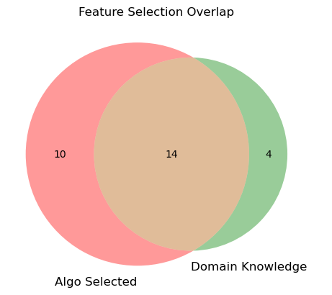
Project 1: Feature Selection
Algo Selected Features
Domain Knowledge Selected Features
Basic premium
Split
Dim_pol_sum_insured
Sum insured
Sum insured
NCB percentage
model
Make
Xc_gwp_prv
Vehicle age
branch
Model
Vehicle age
Policy no
CC
split
Branch
make
Customer postcode
Customer postcode
Customer type
Ncb percentage
Xc_veh_renewal_no
Loss ratio

Slide 11
Project 1: Model Training
  CatBoost
    Developed by Yandex, designed to handle categorical features natively and effectively. It is part of gradient boosting family, like XGBoost and LightGBM.
    Trained a CatBoost Regressor on 3 years of data, tested on 2 years, with extensive data preprocessing and time-based cross-validation.
Feature Importances
Split
Sum insured
NCB percentage
Make
Vehicle age
Model
CC
Branch
Customer postcode
lossratio

Slide 12
Project 1: Model Training
  LightGBM
    Developed by Microsoft, designed for fast, distributed, and efficient gradient boosting.
    Trained a LightGBM on 3 years of data, tested on 2 years, with extensive data preprocessing and time-based cross-validation.
Feature Importances
Sum insured
Model
Split
NCB percentage
Vehicle age
Customer postcode
Branch
Make
CC
Customer Age

Slide 13
Project 1: Model Training
  XGBoost
    Optimized Gradient Boosting framework known for speed and performance. Uses boosted decision trees for regression and classification tasks.
    Trained a XGBoostRegressor on 3 years of data, tested on future 2 years, applied Label Encoding on key categorical features and time-based cross-validation. Tuned for high accuracy and generalizations with 1000 estimators.
Feature Importances
Split
Sum insured
NCB percentage
CC
Vehicle age
Make
GIC
Customer Postcode
Branch
Loss ratio

Slide 14
Project 1: Model Training
  CatBoost
    Parameters –
      Target : GWP
      Features : both numerical & categorical columns
      TimeSeriesSplit (5 folds) to preserve temporal order.
      900 iterations, depth = 8, learning rate = 0.01, L2 leaf regularization = 70, early stopping rounds = 50 to prevent overfitting

Slide 15
Project 1: Model Training
  LightGBM
    Parameters –
      objective : ‘regression’
      Boosting type : ‘gdbt’
      Learning rate : 0.05
      Num_leaves : 31 controls model complexity
      early stopping rounds = 100
      Num_boost_round : 1000 maximum no of boosting iterations
      Feval : [custom metrics] for evaluation
  XGBoost
    Parameters –
      Model: XGBRegressor
      N_estimators : 1000
      Learning rate : 0.05
      Booster : gbtree (default)
      Categorical encoding : branch, cust_type, split. Cust_state, cust_gender, make, model, cc, loss_ratio

Slide 16
Project 1: Model testing and Results
Catboost Performance Overview
Metric | Train (2020-22) | Test (2023) | Test (2024)
R² | 0.849 | 0.842 | 0.814
MAE | 71.06 | 97.47 | 156.26
MSE | 37,017.17 | 62,454.19 | 117,094.56
RMSE | 191.88 | 249.91 | 342.19
LightGBM Performance Overview
Metric | Train (2020-22) | Test (2023)
R² | 0.874 | 0.905
MAE | 69.13 | 85.21
MSE | 27,869 | 37,607
RMSE | 158.31 | 193.92
  XGBoost Performance Overview
Metric | Train (2020-22) | Test (2023) | Test (2024)
R² | 0.946 | 0.898 | 0.86
MAE | 50.21 | 79.62 | 146
MSE | 16,536.32 | 40,320.64 | 88,571.78
RMSE | 116.35 | 200.80 | 297.61

Slide 17
Project 2 : Agent Scorecard
Data Preparation: Raw data, filtered irrelevant rows, grouped data by multiple unique features
Exploratory Analysis: Counted no of policies per agent, conducted multiple levels of groupby
Conceptual Analysis: KPIs such as Frequency, Severity, Agent’s profit margin, Profitability per Policy, Renewal rate
Agent scoring logic (KPIs normalized)

Slide 18
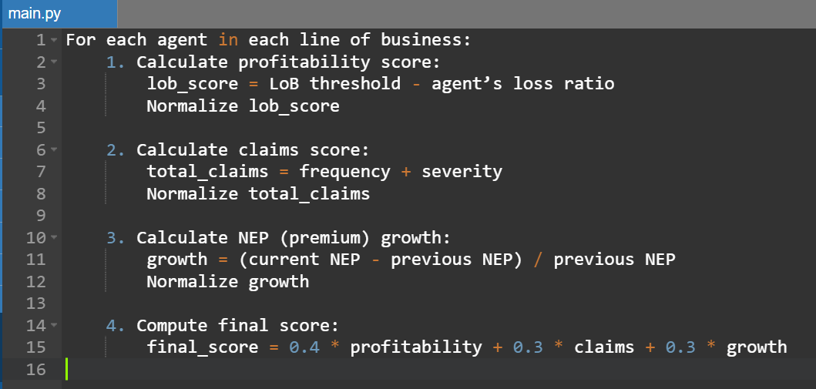
Project 2 : Agent Scorecard
S
C
O
R
E
C
A
R
D
L
O
G
I
C
40% Profitability
30% Claims
30% Revenue Growth
Final score

Slide 19
Result
  Key Takeaways:
    XGBoost shows best training accuracy but slight overfitting.
    LightGBM performs exceptionally on recent test data, fastest training.
    CatBoost is most balanced with consistent performance/strong generalization, low preprocessing and interpretatbility.
  Top predictive Features (all models):
    Split, Sum Insured, NCB %, Vehicle Age, Make, CC, Customer Age, Branch

Slide 20
Conclusion
  CatBoost Model Selection:
    Selected for its stability, categorical data handling and interpretability.
    Consistent performance, even without heavy preprocessing
    Deployment in progress for real-time monitoring via dashboards
  Agent Scorecard:
    Work ongoing on analysis with respect to reporting lines
    Final scorecard will aid in evaluating agent performance and driving business decisions.

Slide 21
Thank You

